Slide 1
Monthly economic webcast:
Improving growth outlook
Eric Lascelles, Chief Economist

Slide 2
Report card
POSITIVE THEMES
U.S. gov’t shutdown resolved
Slight reduction in U.S. tariffs
Possible U.S. stimulus cheques?
Another Fed rate cut likely ahead
Upgrading 2026 growth outlook due to substantial tailwinds

!
✓
NEGATIVE THEMES
Jittery markets express anxiety
Worries about AI bubble continue
U.S. economy decelerates mildly
Dangerous world: military spending rising
INTERESTING
New Japan Prime Minister
UK and France downgrade austerity plans
Internet outage highlights cyber vulnerability
Canadian budget less revolutionary than expected
Gold prices are high
Note: As at 11/27/2025. Source: RBC GAM

Slide 3
On alert for fault lines in markets
Jittery stock market
Concerns over AI valuations, extent of run-up
But economy still growing, gov’t stimulus
AI concerns
Bubble?
Excessive capital expenditures?
But AI likely an important long-term trend
Credit concerns
Worries about private credit, some subprime debt
But credit spreads still quite narrow
Private credit market still fairly small
Private credit illiquidity is a source of stability
Recent defaults have idiosyncratic component
Note: As of 11/27/2025. Source: RBC GAM

Slide 4




Growth tailwinds for 2026
 | U.S. | Canada
Monetary policy | + | ++
Fiscal policy | + | +
Stock market wealth effect | ++ | ++
Oil prices | ++ | +
Overall | ++ | ++
Note: As of 11/21/2025. Source: RBC GAM

Slide 5
U.S. government shutdown
U.S. government shutdown lasted record 43 days
Was more intense than 2019 shutdown
Additional economic damage via essential worker slowdown: flight disruptions, etc.
We budget for ~1 to 1.25ppt chopped off Q4 U.S. annualized GDP growth
Economy bounces back once shutdown is over, plus some catch-up output/spending
New funding only lasts until January 31
Distinct risk of another shutdown in February – Polymarket says 33% chance
Second shutdown would likely be shorter – essential workers less tolerant
Missing economic data starting to trickle out, but some gone forever
Note: As of 11/27/2025. Source: RBC GAM

Slide 6
U.S. average tariff rate now down to 15.9%

Slide 7
Tariff developments
U.S.-China truce
  U.S. reduces China tariff by 10%
  Agreements on rare earths, soybeans, chips
New country deals lower tariffs
  Switzerland 39% → 15%
  Argentina, Ecuador, etc.
New exemptions lower tariffs
  Beef, tomatoes, coffee, tea, tropical fruits (incl. oranges and bananas), fruit juice, cocoa and spices
  Focus on cost of living; Initially targeted products that U.S. doesn’t make, but now getting blurry
Supreme Court
  75% chance IEEPA tariffs go away
  But bilateral deals significantly replace
  And enough other tariff tools in toolkit that White House can still achieve objectives
$2000 cheques?
  But tariff revenue already paying for OBBBA and Bessent says “no”
  But still possible, would add ~1ppt of GDP to deficit + boost growth
U.S.-Canada negotiations hit speed bump
  Pause in talks
  Extra 10% tariff threatened
  Still expect steel & aluminum deal
  USMCA is the big question mark – but probably survives and average tariff rate not much different than now
Milder than feared economic damage
  Effective tariff rate < Theoretical tariff rate
  More sharing of burden across supply chain
  Other economic tailwinds
Note: As of 11/17/2025. Source: RBC GAM

Slide 8
U.S. job market not doing too badly

Slide 9
U.S. consumer slowing slightly

Slide 10
Beige Book points to mediocre U.S. economy

Slide 11
High-income Americans feeling good

Slide 12
Monetary easing – a boost for 2026 economic growth

Slide 13
Canadian consumer cooling

Slide 14
Dubious about recent strong job growth in Canada

Slide 15
Canadian real GDP outlook looking brighter in 2026

Slide 16
European outlook: fiscal support is positive, but need further productivity push

Slide 17
Chinese economy has slowed, but still pretty impressive gains

Slide 18
Gold shines

Slide 19
Dangerous world: rising defense spending

Slide 20

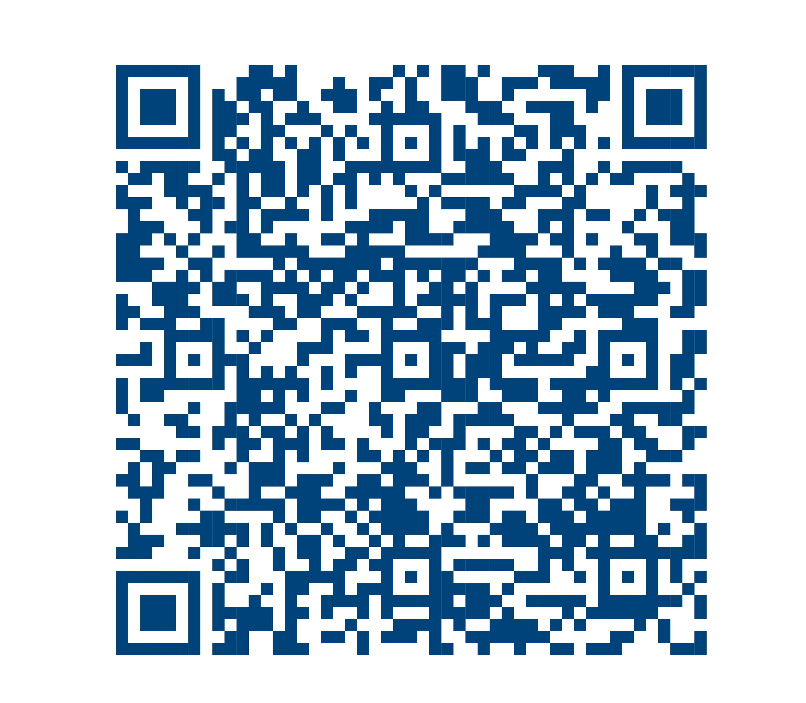

Follow us online
www.rbcgam.com/insights
Stay informed with more insights
www.linkedin.com/in/ericlascelles

Slide 21
Disclosure
This material is provided by RBC Global Asset Management (RBC GAM) for informational purposes only and may not be reproduced, distributed or published without the written consent of RBC GAM or the relevant affiliated entity listed herein. RBC GAM is the asset management division of Royal Bank of Canada (RBC) which includes RBC Global Asset Management Inc. (RBC GAM Inc.), RBC Global Asset Management (U.S.) Inc. (RBC GAM-US), RBC Global Asset Management (UK) Limited (RBC GAM-UK), and RBC Global Asset Management (Asia) Limited (RBC GAM-Asia), which are separate, but affiliated subsidiaries of RBC.
In Canada, the material may be distributed by RBC GAM Inc., (including PH&N Institutional), which is regulated by each provincial and territorial securities commission. In the United States (US), this material may be distributed by RBC GAM-US, an SEC registered investment adviser. In the United Kingdom (UK) the material may be distributed by RBC GAM-UK, which is authorised and regulated by the UK Financial Conduct Authority (FCA), registered with the US Securities and Exchange Commission (SEC), and a member of the National Futures Association (NFA) as authorised by the US Commodity Futures Trading Commission (CFTC). In the European Economic Area (EEA), this material may be distributed by BlueBay Funds Management Company S.A. (BBFM S.A.), which is regulated by the Commission de Surveillance du Secteur Financier (CSSF). In Germany, Italy, Spain and Netherlands the BBFM S.A. is operating under a branch passport pursuant to the Undertakings for Collective Investment in Transferable Securities Directive (2009/65/EC) and the Alternative Investment Fund Managers Directive (2011/61/EU). In Switzerland, the material may be distributed by BlueBay Asset Management AG where the Representative and Paying Agent is BNP Paribas Securities Services, Paris, succursale de Zurich, Selnaustrasse 16, 8002 Zurich, Switzerland. In Japan, the material may be distributed by BlueBay Asset Management International Limited, which is registered with the Kanto Local Finance Bureau of Ministry of Finance, Japan. Elsewhere in Asia, the material may be distributed by RBC GAM-Asia, which is registered with the Securities and Futures Commission (SFC) in Hong Kong. In Australia, RBC GAM-UK is exempt from the requirement to hold an Australian financial services license under the Corporations Act in respect of financial services as it is regulated by the FCA under the laws of the UK which differ from Australian laws. All distribution-related entities noted above are collectively included in references to “RBC GAM” within this material.
This material is not available for distribution to investors in jurisdictions where such distribution would be prohibited.
The registrations and memberships noted should not be interpreted as an endorsement or approval of RBC GAM by the respective licensing or registering authorities.
This material does not constitute an offer or a solicitation to buy or to sell any security, product or service in any jurisdiction; nor is it intended to provide investment, financial, legal, accounting, tax, or other advice and such information should not be relied or acted upon for providing such advice. Not all products, services or investments described herein are available in all jurisdictions and some are available on a limited basis only, due to local regulatory and legal requirements. Additional information about RBC GAM may be found at www.rbcgam.com. Recipients are strongly advised to make an independent review with their own advisors and reach their own conclusions regarding the investment merits and risks, legal, credit, tax and accounting aspects of all transactions.
Any investment and economic outlook information contained in this material has been compiled by RBC GAM from various sources. Information obtained from third parties is believed to be reliable, but no representation or warranty, express or implied, is made by RBC GAM, its affiliates or any other person as to its accuracy, completeness or correctness. RBC GAM and its affiliates assume no responsibility for any errors or omissions in such information. Opinions contained herein reflect the judgment and thought leadership of RBC GAM and are subject to change at any time without notice.
Some of the statements contained in this material may be considered forward-looking statements which provide current expectations or forecasts of future results or events. Forward-looking statements are not guarantees of future performance or events and involve risks and uncertainties. Do not place undue reliance on these statements because actual results or events may differ materially.
® / TM Trademark(s) of Royal Bank of Canada. Used under licence.
© RBC Global Asset Management Inc., 2025
Publication date: November 27, 2025

