Slide 1
Monthly economic webcast:
Soft landing narrative still intact
Eric Lascelles, Chief Economist

Slide 2
Report card

!
POSITIVE THEMES
Soft landing story continues to play out
Prior Beige Book weakness has now unwound
Some recession signals have reversed
Chinese productivity growth is still decent
Risk assets are very happy
NEGATIVE THEMES
Recession remains a key risk
Interest rates are still fairly high
Inflation trend is no longer improving as reliably
Rate cuts may be quite cautious
Chinese housing is still a problem
INTERESTING
BoJ, SNB go in opposite directions
Tech boom not yet visible in economic data
✓
Note: As at 03/26/2024. Source: RBC GAM
Notes:
See text above.

Slide 3
Soft landing still on track, with Beige Book weakness now unwound
Center: W:\Charts\Indicators\Economic Indicators\Beige Book Sentiment.xlsx
Slide_code: Folder\Filename-Tabname-ymd-20220327

Slide 4
High frequency economic data still looks good
Center: W:\Charts\GDP\US GDP.xlsx
Converted to MB
Slide_code: US NYFed WEI vs 2019 W
FWEIW@WEEKLY
Release: Tuesday and Thursday at 11:30 a.m.

Slide 5
Labour market mostly holding together
Center: W:\Charts\Employment-Labour\Employment - Civilian.xlsx
Slide_code: Folder\Filename-Tabname-ymd-20220120
Converted to MB
Release: Weekly Thur 8:30am

Slide 6
Mass layoffs are somewhat higher than normal, but it is not a new development
Center: W:\Charts\Employment-Labour\US WARN Notices.xlsx
Slide_code: Folder\Filename-Tabname-ymd-20220327

Slide 7
News sentiment is soaring
Center: W:\Charts\Trends\News Trends.xlsx
Source: https://www.frbsf.org/economic-research/indicators-data/daily-news-sentiment-index/
Slide_code: Folder\Filename-Tabname-ymd-20220120
Converted to MB
Release: Weekly on Monday

Slide 8
Canadian economic signals also look pretty decent
Center: W:\Charts\Indicators\Economic Indicators\CA Real-time Local Business Conditions Index.xlsx
Slide_code: Folder\Filename-Tabname-ymd-20220120
Converted to Macrobond
Release: Weekly, Friday
StatCan has been slow to update since restoring its website…
As of date usually lags our deck release 2 weeks

Slide 9
Many economies are weak, but not actually suffering
Center: W:\Charts\GDP\GDP vs unemployment gap - international.xlsx
Slide_code: Folder\Filename-Tabname-ymd-20220327

Slide 10
Inflation picked up in recent months, and may remain robust in March
Center: W:\Charts\Inflation\PriceStats Inflation Rates.xlsx
Slide_code: Folder\Filename-Tabname-ymd-20220106
Release: daily weekdays.
**DO NOT provide underlying data to anyone**

Slide 11
Inflation is still in a tricky place, as per business pricing plans
Center: W:\Charts\Surveys\NFIB Surveys.xlsx
Slide_code: Folder\Filename-Plan to Raise Price (MB)-ymd-20210728
Converted to MB
Updated 03/12/2024
Notes:
Businesses possess pricing power. They plan to pass through their own cost increases, keeping inflation high for longer even after the original input pressures begin to abate.

Slide 12
Inflation expectations believe inflation could get stuck in the 2.5-3.0% range
Center & left: W:\Charts\Inflation\Inflation_trend-US_CA_EU.xlsx
Slide_code: Folder\Filename-Tabname-ymd-20220629
VL
Updated 03/12/2024

Slide 13
Soft landing and stubborn inflation argue for only gradual rate cuts, but historical easing cycles have been fast
Center: W:\Charts\Monetary Policy\Fed funds rate overtime.xlsx
Slide_code: Folder\Filename-Tabname-ymd-20220327

Slide 14
Canadian productivity woes got even worse in the latest quarter
Center: W:\Charts\GDP\CA GDP.xlsx
Slide_code: Folder\Filename-Tabname-ymd-20220327

Slide 15
Excitement about artificial intelligence swells
Center: W:\Charts\Trends\GoogleTrendsAI.xlsm
Slide_code: Folder\Filename-Tabname-ymd-20220327

Slide 16
But research and development isn’t surging yet
Center: W:\Charts\Investment & Inventories\US Fixed Investment.xlsx
Slide_code: Folder\Filename-Tabname-ymd-20220327

Slide 17
And capital expenditures on computers have fallen recently
Center: W:\Charts\Investment & Inventories\US Fixed Investment.xlsx
Slide_code: Folder\Filename-Tabname-ymd-20220327

Slide 18
Chinese productivity growth is declining, but still good
Center: W:\Charts\GDP\China GDP.xlsm
Slide_code: Folder\Filename-Tabname-ymd-20220327

Slide 19
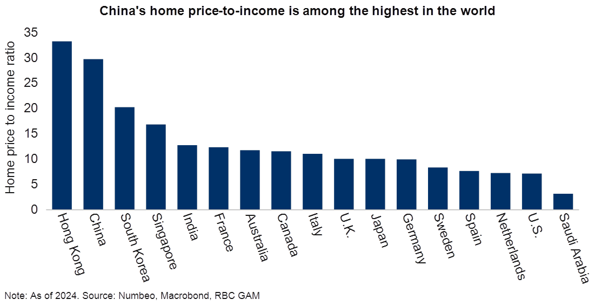
China’s housing market remains problematic, including poor affordability
Center: W:\Charts\Housing\World Home Price to Income.xlsx
Slide_code: Folder\Filename-Tabname-ymd-20220327
Converted to MB

Slide 20



Follow us online
@RBCGAMChiefEcon
www.linkedin.com/in/ericlascelles
www.rbcgam.com/insights

Slide 21
Disclosure
New disclosure effective 4/28/2023
This document is provided by RBC Global Asset Management (RBC GAM) for informational purposes only and may not be reproduced, distributed or published without the written consent of RBC GAM or its affiliated entities listed herein. This document does not constitute an offer or a solicitation to buy or to sell any security, product or service in any jurisdiction; nor is it intended to provide investment, financial, legal, accounting, tax, or other advice and such information should not be relied or acted upon for providing such advice. This document is not available for distribution to people in jurisdictions where such distribution would be prohibited.
RBC GAM is the asset management division of Royal Bank of Canada (RBC) which includes RBC Global Asset Management Inc., RBC Global Asset Management (U.S.) Inc., RBC Global Asset Management (UK) Limited, and RBC Global Asset Management (Asia) Limited, which are separate, but affiliated subsidiaries of RBC.
In Canada, this document is provided by RBC Global Asset Management Inc. (including PH&N Institutional) which is regulated by each provincial and territorial securities commission with which it is registered. In the United States, this document is provided by RBC Global Asset Management (U.S.) Inc., a federally registered investment adviser. In Europe this document is provided by RBC Global Asset Management (UK) Limited, which is authorised and regulated by the UK Financial Conduct Authority. In Asia, this document is provided by RBC Global Asset Management (Asia) Limited, which is registered with the Securities and Futures Commission (SFC) in Hong Kong.
Additional information about RBC GAM may be found at www.rbcgam.com.
This document has not been reviewed by, and is not registered with any securities or other regulatory authority, and may, where appropriate, be distributed by the above-listed entities in their respective jurisdictions.
Any investment and economic outlook information contained in this document has been compiled by RBC GAM from various sources. Information obtained from third parties is believed to be reliable, but no representation or warranty, express or implied, is made by RBC GAM, its affiliates or any other person as to its accuracy, completeness or correctness. RBC GAM and its affiliates assume no responsibility for any errors or omissions.
Opinions contained herein reflect the judgment and thought leadership of RBC GAM and are subject to change at any time. Such opinions are for informational purposes only and are not intended to be investment or financial advice and should not be relied or acted upon for providing such advice. RBC GAM does not undertake any obligation or responsibility to update such opinions.
RBC GAM reserves the right at any time and without notice to change, amend or cease publication of this information.
Past performance is not indicative of future results. With all investments there is a risk of loss of all or a portion of the amount invested. Where return estimates are shown, these are provided for illustrative purposes only and should not be construed as a prediction of returns; actual returns may be higher or lower than those shown and may vary substantially, especially over shorter time periods. It is not possible to invest directly in an index.
Some of the statements contained in this document may be considered forward-looking statements which provide current expectations or forecasts of future results or events. Forward-looking statements are not guarantees of future performance or events and involve risks and uncertainties. Do not place undue reliance on these statements because actual results or events may differ materially from those described in such forward-looking statements as a result of various factors. Before making any investment decisions, we encourage you to consider all relevant factors carefully.
® / TM Trademark(s) of Royal Bank of Canada. Used under licence.
© RBC Global Asset Management Inc., 2024
Publication date: March 28, 2024
Do this at the beginning of each year:
Update year at the end of copyright clause.
New as of 8/10/2016: Use original posting date or date of presentation, whichever is applicable, for “Publication date”.

